Slide 1

E.D.A.A. Emotion Detection and Analysis
Created By : The Mystic Forces (Aamir, Hemani, Ibtisam)
1

Slide 2
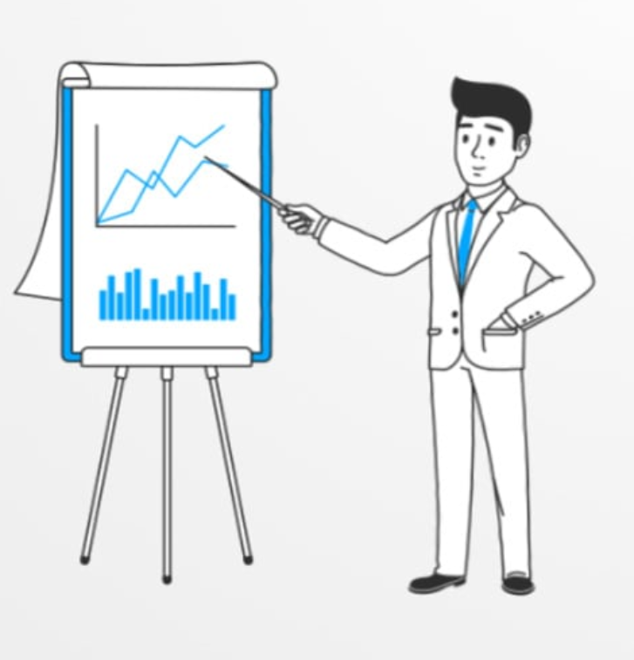
Remember the first time you had to give a presentation?
2

Slide 3

Do you remember how nervous you were? Did you shiver with the fear?
3

Slide 4
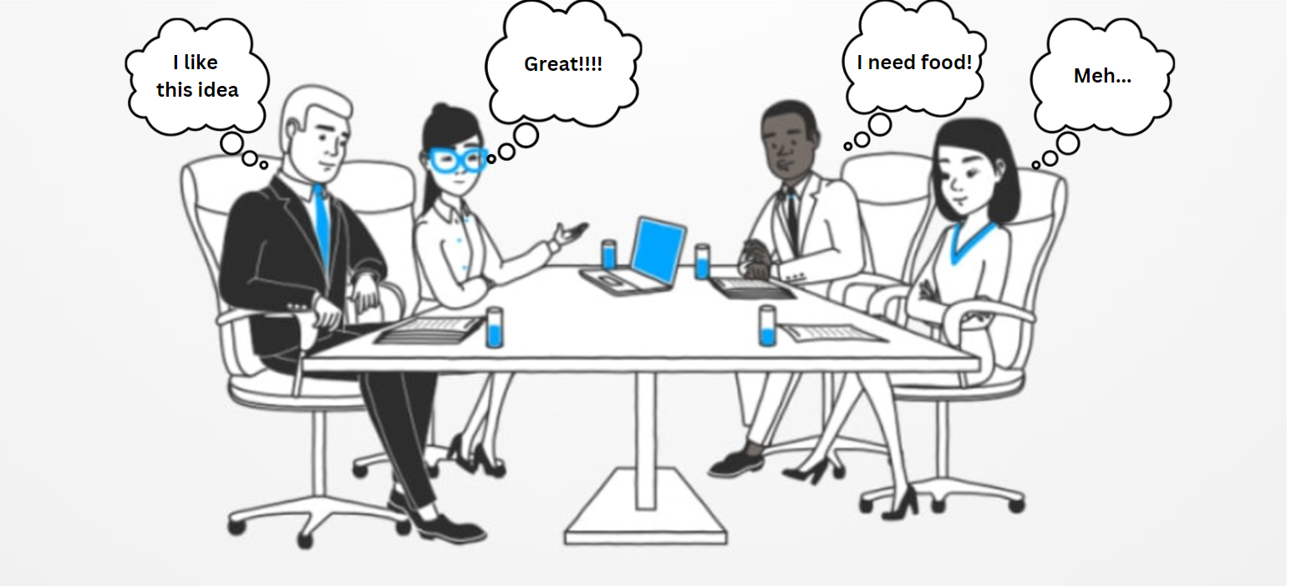
Did you wish you could read minds?
Just know what to say to satisfy your audience.
4

Slide 5
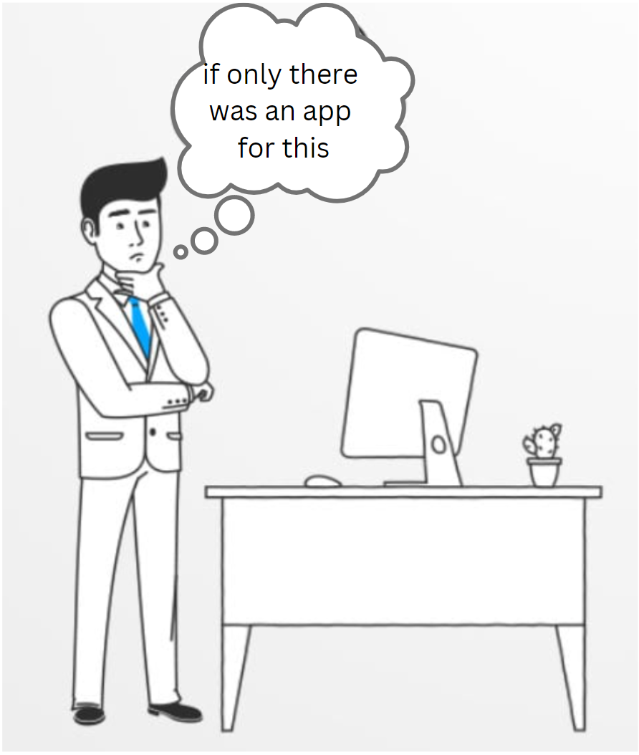
EDAA to the rescue!
Didn’t you wish there was an application that could give you statistics about your audience’s behavior?

Slide 6
What is EDAA? – Our Vision
EDAA is a smart web application
Coupled with your meeting applications can be used to:
gain real-time analysis of your speech
receive live feedback using visual analysis of your audience’s facial reactions.
It creates a report of audience reactions.
It takes into consideration:
video (facial expressions of the audience)
text (context of the speech)
5

Slide 7









Models, techstack and tools used:
Models used:
Techstack/Tools used:
Yolo-v7
ReactJS
NGINX
FastAPI
SBert
Google Cloud Platform
Github
Docker
OpenAI-Whisper
6

Slide 8
Web Architecture
Audio chunks
Text
sentences
text
prediction
.
.
.
ASR container
SBert
container
video
prediction
YOLO container
GCS
Bucket
Input Video
React
Frontend
Pre-processor
API main
Video chunks
.
.
.
Video
chunks
Final
results
7

Slide 9
EDAA DEMO!
8

